Slide 1
Distributed Programming & Networking – 2020/2021
Project Proposal: Covid-19 Engagement Ecosystem
Group Members: Amparo Soeli Betancourt Tarifa, Anwai Archit, Santiago Pires and Sheikh Adilina
(amparosoeli.betancourttarifa@studentmail.unicas.it, anwai.archit@studentmail.unicas.it, santiago.pires@studentmail.unicas.it, sheikh.adilina@studentmail.unicas.it)

Slide 2
Outline
Abstract
Mockup of the Application (must, should, could haves)
Client Side Languages
Server Side Languages

Slide 3
Abstract

Slide 4
Abstract
As the current global pandemic has evolved with thousands of cases everyday, it has been hard for labs and small medical centers to keep up with the information, appointments for Covid-19 tests and recent scheduling of vaccination.
In some nations, this is still being handled manually and that is why it is necessary to implement a user friendly web page to schedule testing and vaccination, which also allows the user to access the results without the need of exposing themselves and others by going out. Also this web page would allow doctors to upload patients results and keep track of them.
It would indeed allow the users in need to purchase medical supplies.

Slide 5
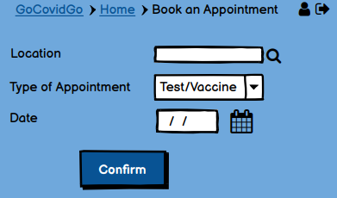
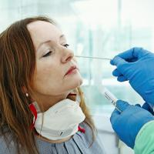
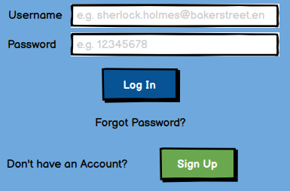
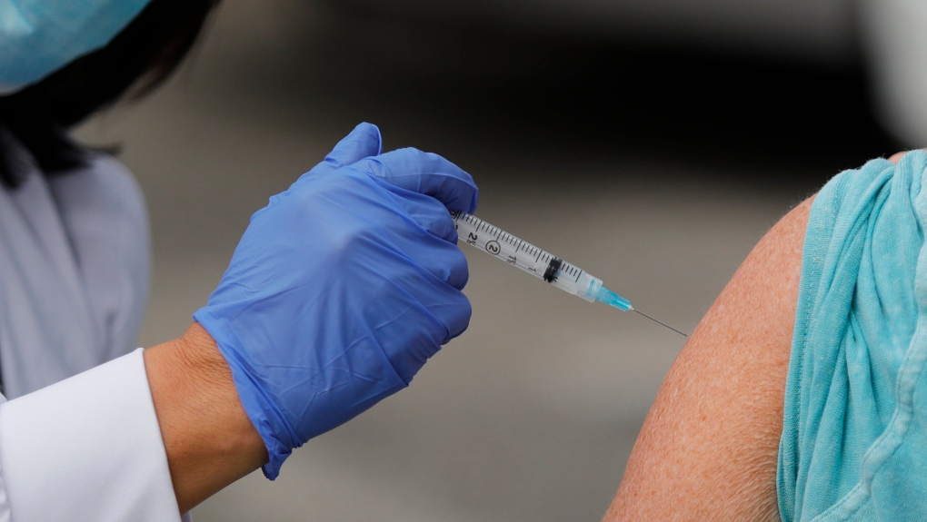
Goals of the Project
Ease of Booking an Appointment
Interactions (Information and Studies)
Purchase Medical Equipments Online

Slide 6
Mock Up

Slide 7
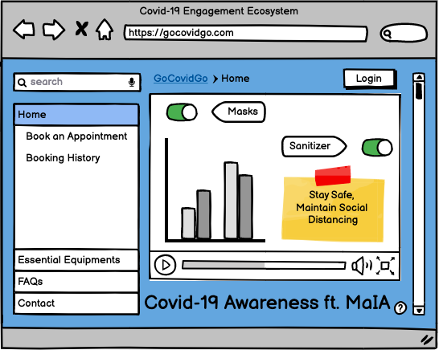
Home Page (must have)

Slide 8
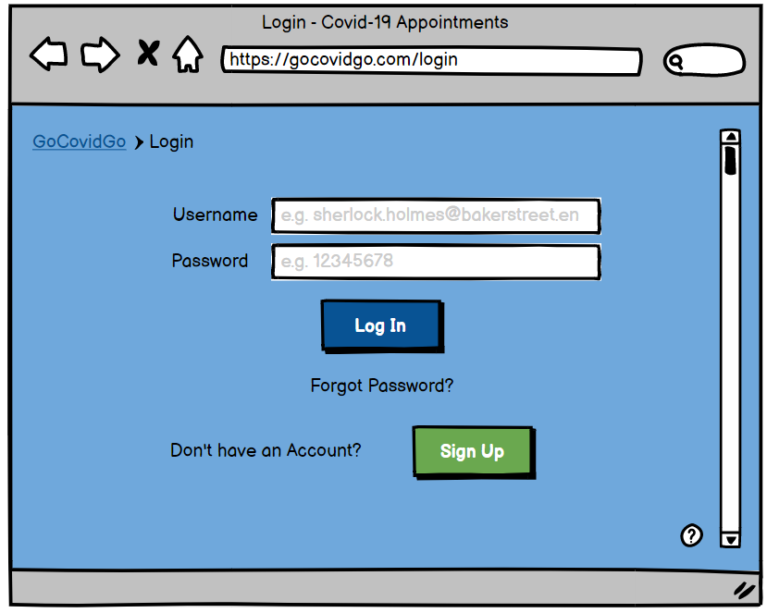
Mockup - Log In Page (must have)
For every user:
Be able to log in

Slide 9
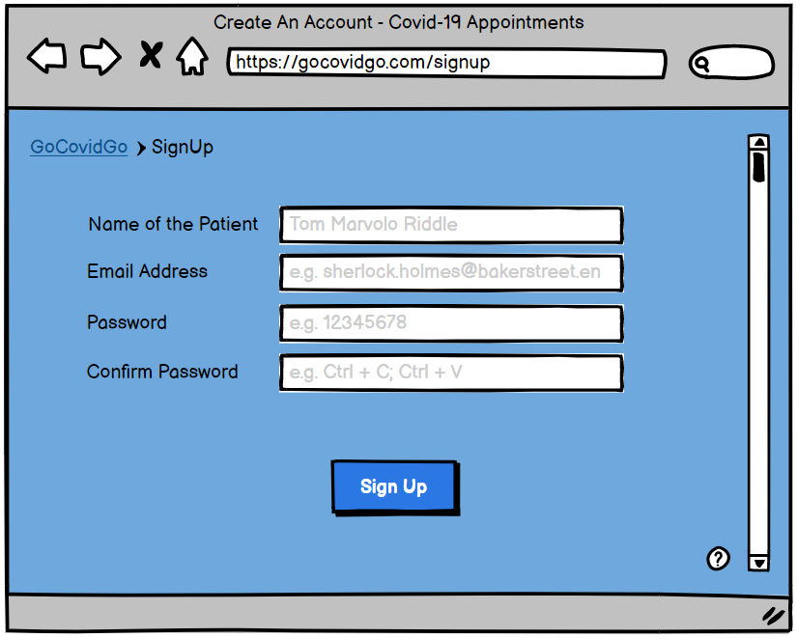
For Patients
Be able to Sign Up,
Edit Personal Information and Upload Files,
Book an Appointment,
View Booking History
(should have - Mockup)

Slide 10
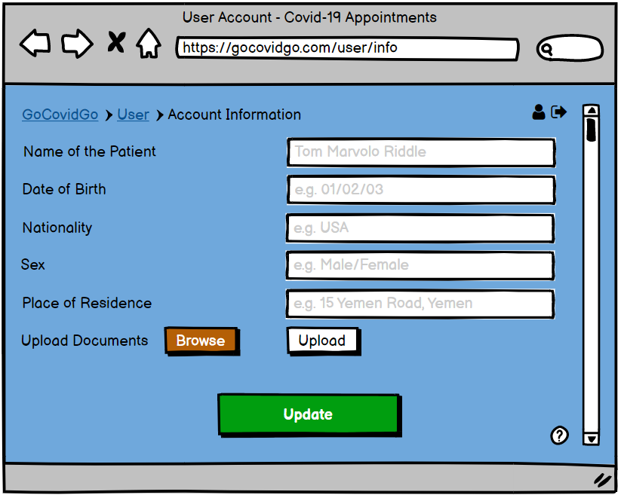
Edit Information & Upload Files (must have)

Slide 11
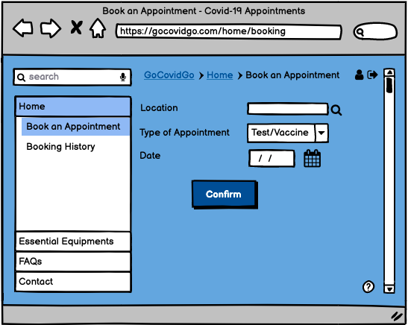
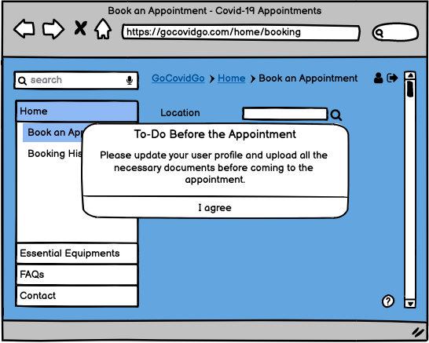
Book an Appointment (should have)

Slide 12
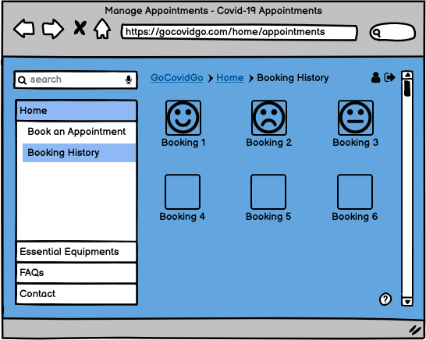
View Booking History (should have)

Slide 13
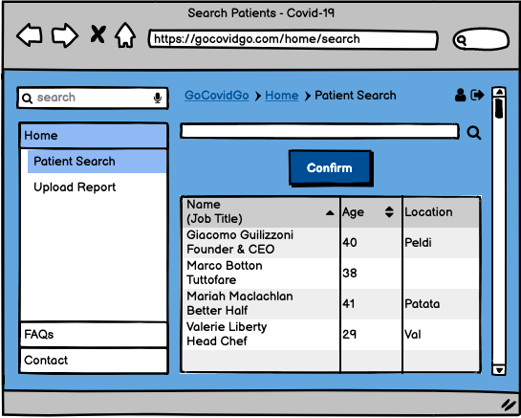
For Administrators & Doctors (could have)
Be able to search for a patient

Slide 14
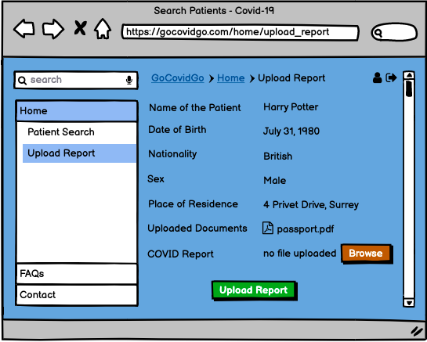
For Administrators & Doctors (could have)
Be able to upload COVID report

Slide 15
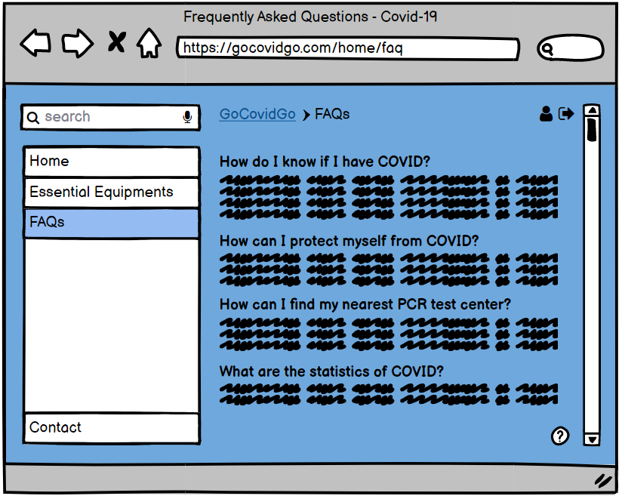
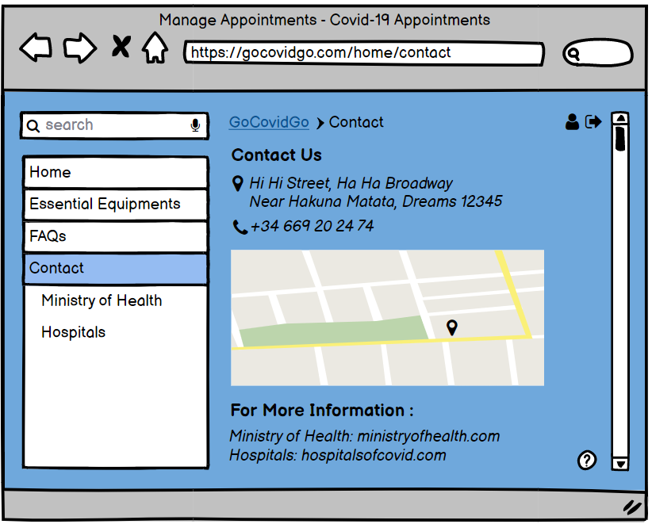
FAQ and Contact Pages (should have)

Slide 16
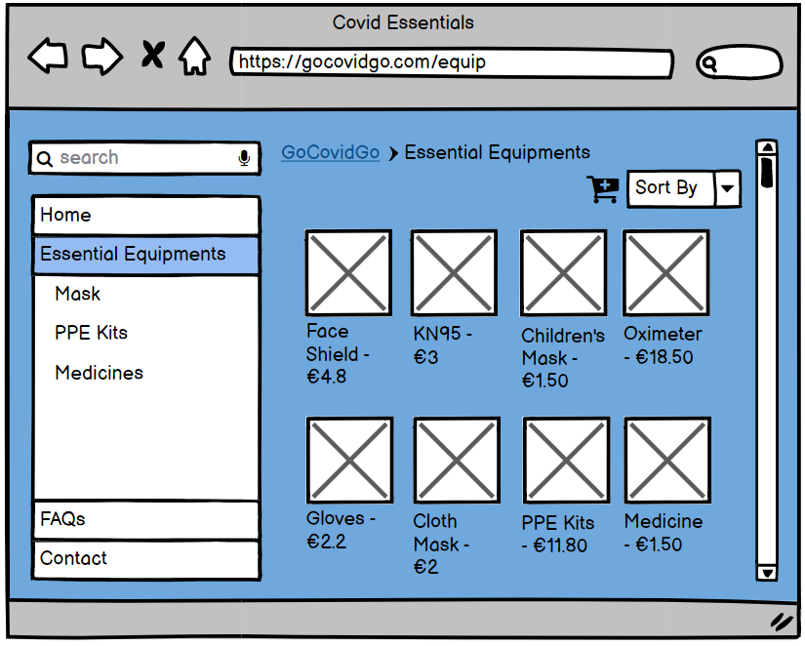
Buy Medical Supplies (could have)
For patient:
Browse Medical Supplies, if not making a purchase. (maybe)

Slide 17
Client Side

Slide 18

Client Side
HTML
CSS
Javascript
2 types of users:
Patients:
Log In as Patients.
Complete Profile with Medical Information.
Book Appointment for Vaccine or PCR.
Download Results.
Buy Medical Supplies (maybe).
Administrators and doctors:
Log In as Administrators.
Upload Results for Specific Patients.

Slide 19
Server Side

Slide 20
Server Side
Node.js
Express
MongoDB
Environment: Node.js
Express -> App
Express-handlebars -> adequate website to user
FS -> Be able to search for a file
Multers -> To upload files
MongoDB with Mongoose -> Patient information, appointments
Others: body-parser, connect-flash, method-override, express-session

Slide 21
Project Timeline

Slide 22
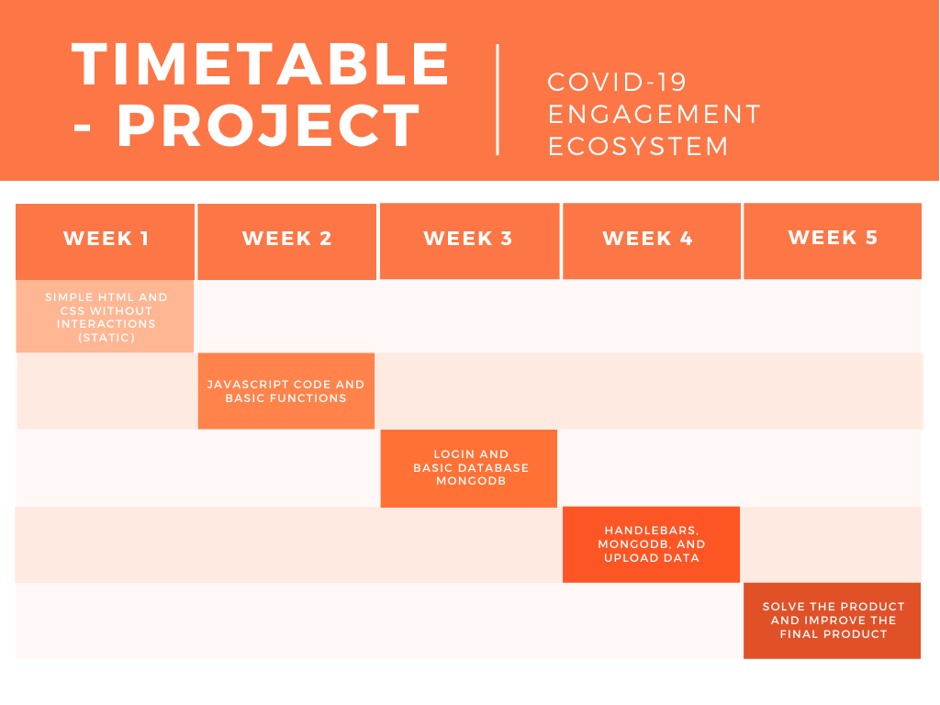
Timetable

Slide 23
Thank You For Your Attention! :D
Any Questions?

